Slide 1
Application Development Document Imaging
Shared Services Imaging Services & Support
March 2014

Slide 2
Document Imaging Overview
Who We Are – Who We Should Be
Business Services Partnership & Collaboration
Document Imaging Technology & Services
Application Technology & Business Line Benefits
Current Environment - Projects
Challenges and Risk
Future deployment and strategy

Slide 3
Who We Are Today
David Rey (FTE)
Systems Manager
Kim Liebler (FTE)
Team Lead
BA
Kristan Plath (FTE-30 hr.)
G. Venkateshmurthy(SLK Onshore)
Programmers
Ashish Vikram (FTE)
Shiva Kadrolli (SLK Offshore)
Pooja Purushan (SLK Offshore)
QAT
Sunil Kulkarni (SLK Offshore)

Slide 4
Who We Should Be – Resource Structure
Recommended Additional Roles
Business Analysts/PM
Add 2 FTE
Technical Programmers
Add 1 FTE
Quality Assurance Testers
Replace 1 Tester FTE
David Rey (FTE)
Systems Manager
Kim Liebler (FTE)
Team Lead
BA
Kristan Plath (FTE-30 hr.)
FTE Request 1
FTE Request 2
G. Venkateshmurthy(SLK Onshore)
Programmers
Ashish Vikram (FTE)
FTE Request 1
Shiva Kadrolli (SLK Offshore)
Pooja Purushan (SLK Offshore)
QAT
FTE Request 1 (Replacement)
Sunil Kulkarni (SLK Offshore)
BA
Kristan Planth (FTE-30 hr.)

Slide 5
Partnerships & Collaboration
Current Areas of Coverage
18 Production Applications:
Lending Services
COS – Commercial Closing/Collateral
COS_CIW – Commercial Imaging Workflow
COS_IPC – Indirect Post Closing
COS_RPC – Retail Post Closing
MDR – Mortgage Document Retention
MGD – Mortgage Lien Release
Consumer Lending
COS_RCL – Retail Credit and Closing
COS – Indirect Credit Lending
COS – Dealer
Human Resources
HRI – Human Resources
Commercial Cash Management
TMH – Treasury Mgmt & Agreement Housing
Central Operations
ACQ – Acquisitions
RMR – Records Management Repository
M&T Trust &Investments
TIW – Trust and Investments
M&T Securities
MTS – M&T Securities, Insurance, & Licensing
Finance
APO – Accounts Payable
Retail
BDA- Branch Document Access
Compliance
Universal Search
Document Imaging Technology
Lending Services
Consumer Lending
Human Resources
Central Operations
Commercial Cash Management
M&T Trust and Investments
M&T Securities
Finance
Compliance
Retail
Technical Counterparts
WAP- Platform
Enterprise Service Bus
Database Services
Enterprise Business Objects
Information Security
Network Client Integration (Messaging)

Slide 6
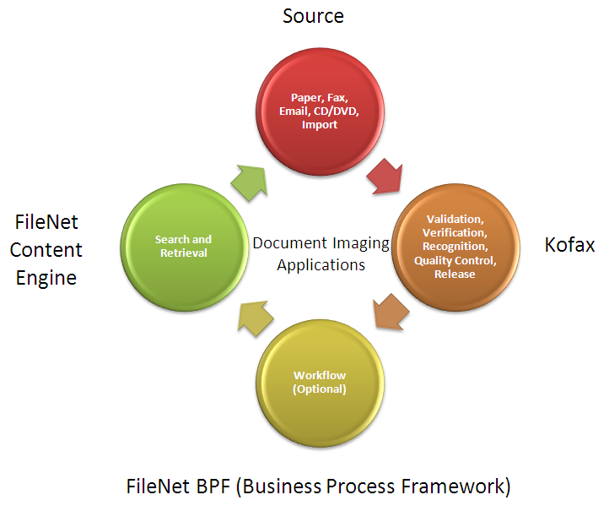
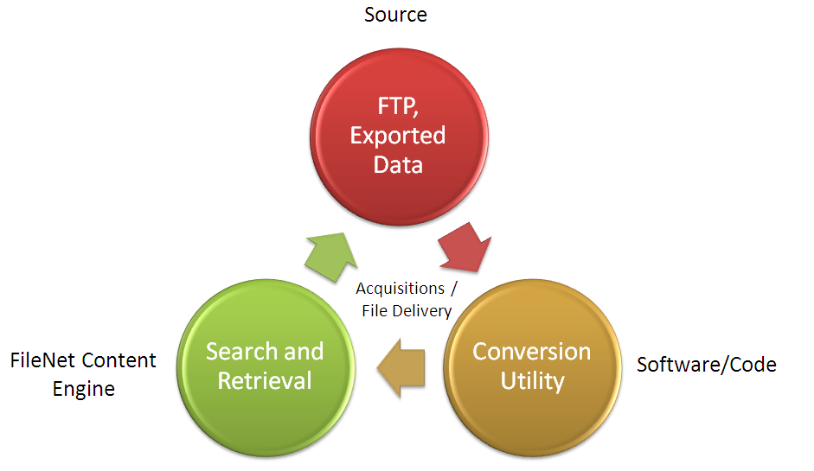
What Is Document Imaging?

Slide 7
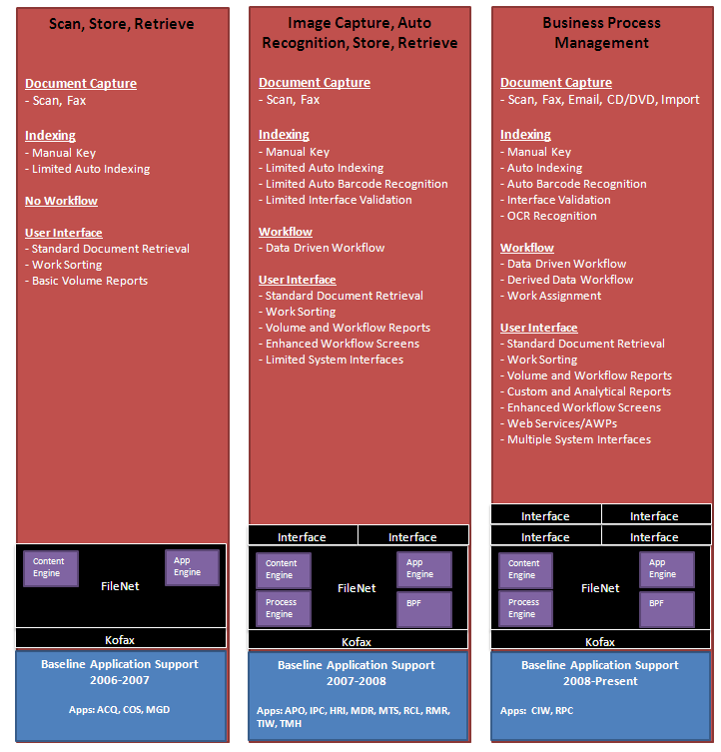
A Technology Evolution

Slide 8
Benefits of Document Imaging
Expense Reduction:
Reduction in time required to create, manage and distribute content
Reduction in material costs including paper, folder, etc.
Reduction in costs associated with legal discovery
Reduction in time spent looking for lost or missing documents
Improved Efficiency:
Reduction in overhead by using automated processes and workflow
Used to help business areas identify annual benefits for their document imaging projects.
Improved Customer Service:
Immediate access to documents
Greater collaboration within and among departments
Improved Service Level Agreements (SLA’s)
Access Management:
Document control to protect customer confidentiality
Document level security
Produce immediate document-level audit trails
Legal/Regulatory:
Controlled storage for unaltered documents
Improved efficiency in storage, retention and disposition of records

Slide 9
Current Environment
Projects
Projects managed and execute end-to-end all approved imaging project requests
50 projects implemented in 2014
24 projects implemented in 2013
On average, Document Imaging implements 2 brand new applications per year without increasing staff
2014: Implemented Indirect Dealer Files and Indirect Credit Lending
2013: Implemented Compliance Universal Search
Production Support (BAU)
BA’s support over 6,000 production users encompassing 18 unique applications
In 2014 alone, the Document Imaging Team worked approximately 267 production tickets/issues. This does not include the number of issues reported by business partners via email/phone that our analysts support
Vendor Management
The Imaging team manages relationships and supports products / services purchased from the vendors:
Kofax (Document Capture software, aka “front-end “ to FileNet)
IBM/Neocol (Document Retention/Storage/Workflow/ Upgrades)
Snowbound (Document Retrieval Software)

Slide 10
Projects
Active Projects - 16
Platform Upgrade - FileNet Upgrade to 5.2
IRIS to FileNet High Resolution Docs
CRE Email Change
RMR W-9 Escrow Agiletics
RPC Heloc Critical Error
Platform Upgrade - Windows 7
Mortgage Document Repository - Loading and Extractions--ONGOING
PR 2889 BOA Repurchasing (extract)
PR 2895 MD CDA Conversion
PR 2897 Bayview Conversion
PR 2900 Mortgage Assignments
PR 2901 RLMS Conversion
Mortgage Workflow and retrieval
Platform Upgrade Kofax- Citrix Upgrade
COS_Funds Transfer Agreement
Human Resource Data Content Management System
Human Resource Replace Recombo and store Images in FileNet
Human Resource Personal File Extraction
Mortgage Document Repository OnBase Transmission Delete
CAM Paperless Back Office
RCC Thick File

Slide 11
Projects
Projects Currently Schedule To Start in Q2 – 12 Projects
WT Converted Images to FileNet (fiche/film)
Blitz Doc to FileNet-Vendor reduction
CAM Mortgage Doc types- Ongoing effort
RPC_Product Change
RPC Shaw Validation
Adobe Upgrade
Platform Upgrade - Kofax Upgrade-2015 (Q3)
AML- ECM File Share
Workflow Applications conversion to ECM
RMR Kofax Email Additions
Banko Document Deactivation
Problem Loan Management – Credit

Slide 12
Challenges and Risks
The team is overextended in the BA, QA and Programmers space
BA’s/Programmers have no segregation between production support and project work
We have 1 technical programmer FTE. This is a challenge when splitting between production work, project work, guiding offshore staff, and managing vendors. There is currently no onsite backup available for time away (vacations, illness, etc.)
Managing business partners expectations, concerns, and requests due to working in a reactive state
Project timelines are at risk, pending production support issues
Responsiveness to production support notifications/communications may be delayed
BA’s act as Project Manager for all imaging related work, in addition to their regular responsibilities, which impacts effectiveness
Technology knowledge transfer and training is limited with 1 technical FTE
Approaches to solutions may be reactive and delayed due to lack of resources and/or lack of expertise
Long term planning/process improvement is not being reviewed at the appropriate level due to resource constraints
Business outreach on future planning, initiatives, etc. is limited
Imaging policies, standards, and procedures are outdated

Slide 13
Preparing for Tomorrow
Enterprise Content Management
Strategy
Industry Best Practices
Technology
Enterprise Case Management
Strategy
Industry Best Practices
Technology

